Slide 1
Employee Data Analysis using Excel
STUDENT NAME. : Santhosh . R
REGISTER NO : 312201062
NM ID : 22ADD720D937A81AAD14A5DDE20CEF1C
DEPARTMENT : B.COM (ACCOUNTING AND FINANCE)
COLLEGE : D.R.B.C.C.C.HINDU COLLEGE

Slide 2
PROJECT TITLE
Employee Performance Analysis using Excel

Slide 3


AGENDA
Problem Statement
Project Overview
End Users
Our Solution and Proposition
Dataset Description
Modelling Approach
Results and Discussion
Conclusion
3/21/2024 Annual Review

Slide 4

PROBLEM STATEMENT
Employee performance analysis is a method that enables the understanding of each team member's strong and weak points. It helps managers understand where improvement should be expected or where support is required. Productivity increases once resources and training are channeled into clearly identified areas. Performance analysis creates clear expectations and allows the facilitation of transparency and accountability. Targeted feedback and training support employee development, improved job satisfaction, and retention. Alignment of individual goals with organizational objectives ensures the efforts of all drive toward company success with a motivated team.

Slide 5

PROJECT OVERVIEW
In this project, employee performance will be analyzed based on data with respect to Business Unit, Employee Status, Employee Type, Performance Score, and Current Employee Rating. This project looks for strengths, areas of concern, and derives recommendations of strategies that will lead to better performance and employee development in the organization..

Slide 6

WHO ARE THE END USERS?
1. HR Professionals: Analyze performance in order to guide decisions related to promotions, compensation, training, and workforce management.
2. Team Managers and Team Leaders: They review the team performance data, provide feedback, establish goals, and identify areas of improvement to help align a team's objectives to the organizational objectives.
3. Senior Executives and Management: They evaluate performance among departments, understand the trend in productivity, and take strategic decisions accordingly.
4. Workforce: They can use their performance data to assess themselves, understand how they are perceived within the organization, and find personal development opportunities.
5. Learning and Development Teams: They analyze performance data to identify skill gaps and develop targeted training programs. 6. **Compensation and Benefits Specialists**: They analyze performance data to determine bonuses, pay raises, and financial rewards based on employee performance.
7. Talent Management Teams: They use performance analysis for talent identification regarding leaders or critical role.

Slide 7

OUR SOLUTION AND ITS VALUE PROPOSITION
1. Conditional Formatting: Highlight the missing value in data. This gives a quick, at-one-glance view of where the gaps are that will need attention.
2. Filter: use filtering to eliminate or focus on selected rows containing missing values. Therefore, this approach simplifies the cleaning of the data for more efficient analysis, focused only on complete records.
3. Formula: Different formulas will be applied in order to accurately compute the performance metrics. Such practice will significantly help quantify the performances of employees effectively.
4.Pivot Table: Manufacture pivot tables, which should be used in the summarizing of data on the basis of various categorizations, such as for department or time period, to ascertain and highlight the unidentified underlying pattern that may be in the data or its trend.
5.Graphs: Graphs are powerful for making data visual through their facility to have people compare and analyze performance metrics of different groups or over time..

Slide 8
Dataset Description
Employee dataset : Collected from edunet foundation
Features : there are 26 features
Main features are,
Employee id : unique identify number for employee
Name : employee’s first and last name in letters
Employee type : it identifies whether they are part time or contract or full time employer
Employee department : it identifies the department
Gender : it is considered as male and female
Employee rating : rating are in numeric value
`

Slide 9

THE "WOW" IN OUR SOLUTION
Calculated the Performance level using the formula
IFS(Z8>5,”VERYHIGH”,Z8>=4,”HIGH”,Z8>=3,”MED”,TRUE,”LOW”)
3/21/2024 Annual Review
9

Slide 10
MODELLING
Data Sources:
Performance ratings are differentiated by employee type - Contract, Full-Time, Part-Time - and levels - HIGH, MEDIUM, LOW, VERY HIGH - business-unit-wise.
Tools Used:
1. Pivot Table: Provides the count of employees in each performance category by business unit, filtered by employee type.
2. Slicers: Allows dynamic filtering of data by employee type for focused analysis.
3. Graph: Presents the distribution of performance levels across business units and hence makes data comparison and interpretation easier.
10

Slide 11
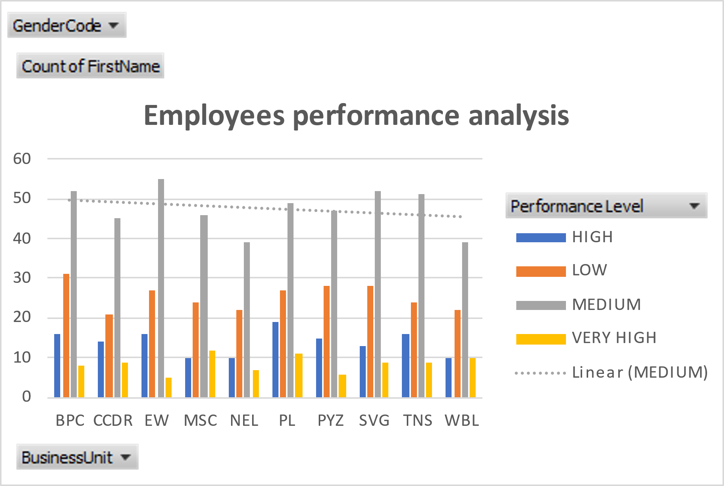
RESULTS
11

Slide 12
conclusion
1. Medium Performers: The majority of all employees in all business units perform at a "Medium" level, reflecting consistency in performance across the organization.
2. Poor performers: Divisions like BPC and CCDR have a greater share of employees highlighted as low performers.
3. High and Very High Achievers: Business units like EW and PL have higher representations of "High" and "Very High" achievers, reflecting improved performance in those areas.
4. Areas of Improvement: Every unit with more low performers would need targeted interventions, while units with fewer top performers might need to develop strategies that increase high-level performance.

